Slide 1

Latest Trends in Sales Data
How we can use trends in sales to better predict and optimize future business decisions

Slide 2
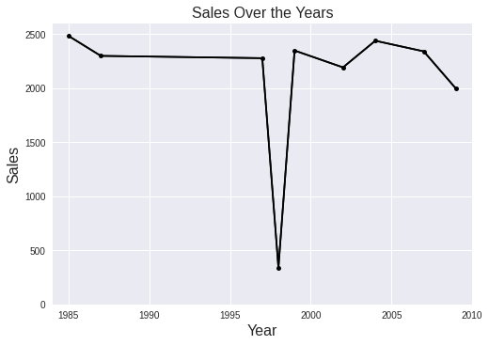
Sales Trends Over The Past 25 Years
Have been fairly static outside of anomaly in mid 90s
Worth further investigating years of upward trend in sales data vs downward trends in sales data and comparing differences in potential factors leading to each

Slide 3
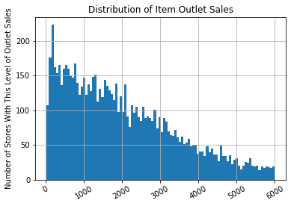
How much do stores raise on average from item outlet sales?
Most Stores produce around $1000-2000 in item outlet sales on average per day
Takeaway: Continue this trend, further investigate common trends amongst stores that are at the left of this distribution

Slide 4
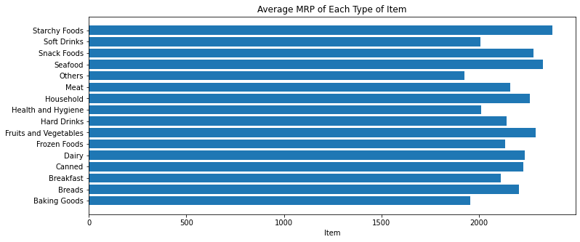
Mean retail price(MRP) of different types of food items
Starchy foods, snacks, seafoods, fruits and vegetables tend to have the highest retail price
Worth further investigating what price optimizes the most sales. In particular while foods like seafood it makes sense to have the highest mean prices, a lot of starchy foods or snacks often aren’t typically associated with the most expensive foods at a store
Can sales of those products increase by lowering the price?

Slide 5
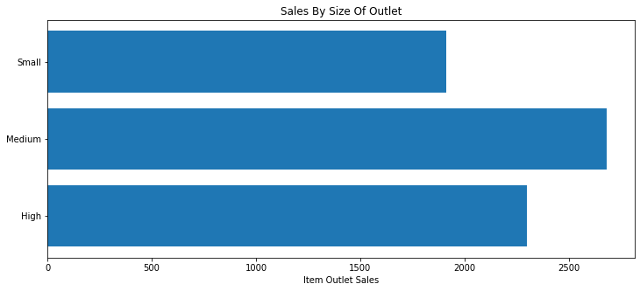
How much does outlet sales vary by size of outlet
Interestingly medium sized outlets have the greatest sales
Takeaway: worth further looking into why medium sized outlets tend to do better than larger ones from outlet sales?

Slide 6
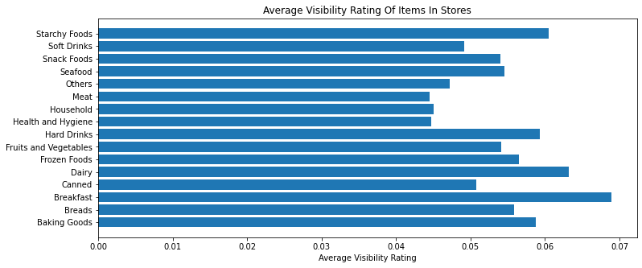
How VISIBLE are ITEMS at Stores?
Unsurprisingly starchy foods breakfast foods and dairy tend to be easiest to see?
Interestingly no strong correlation(<0.2) between sales of items vs their visibility
No real correlation also with mean retail price of an item vs its visibility
Takeaway: can changing the visibility of some items improve sales?

Slide 7
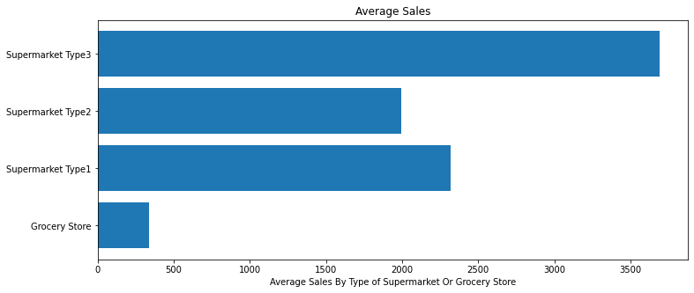
How much does Size of supermarket/grocery store(not overall outlet) affect sales prices
As expected bigger supermarkets specifically tend to produce more in the way of average sales

